Slide 1




Startup Funding & Support Management System

Slide 2






ABSTRACT
The Startup Support System is a centralized platform that connects founders, investors, mentors, and support programs. It manages startup registration, funding rounds, mentorship, and resources in one place. By linking key entities like Startups, Founders, Investors, and Programs, the system improves collaboration, transparency, and decision-making. This project aims to simplify the startup ecosystem and promote innovation and growth.

Slide 3
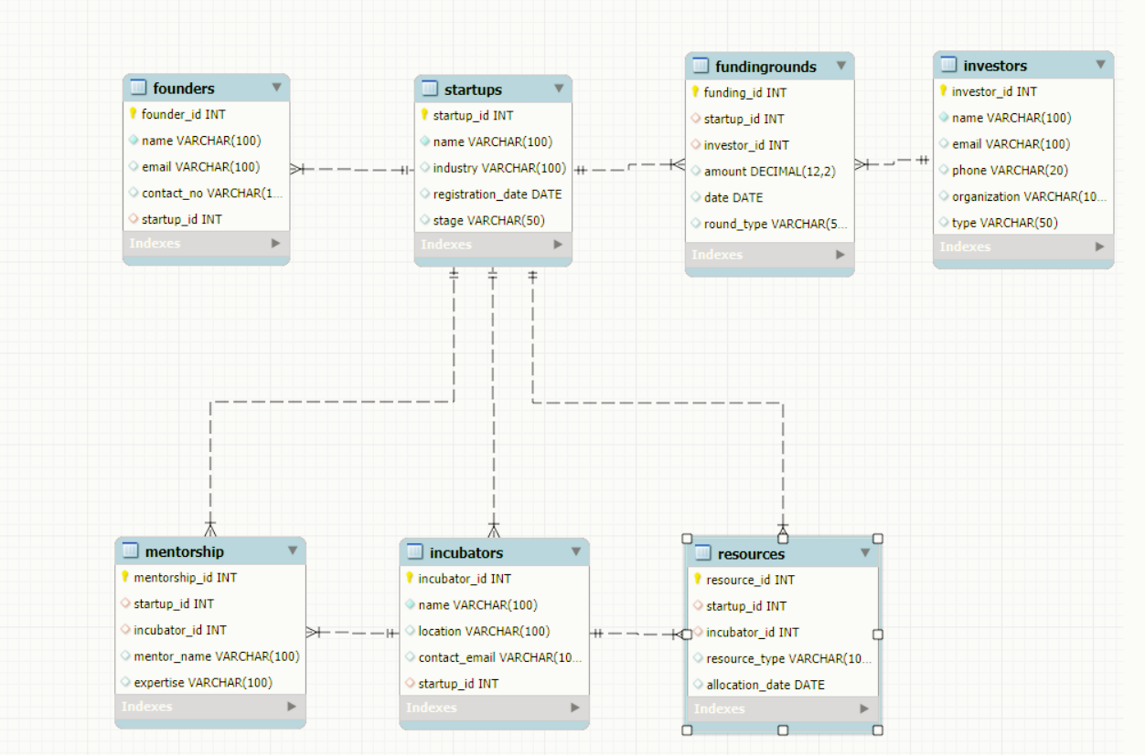

Slide 4

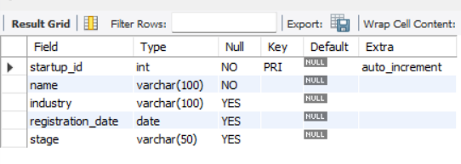
STRUCTURE OF A TABLE
STARTUPS TABLE:
Contains details about startups such as name, industry, registration date, and current stage.
Acts as the central table linking to founders, investors, and incubators.
Syntax : desc startups;

Slide 5
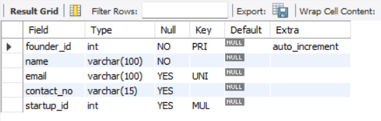
STRUCTURE OF A TABLE
Founders Table:
Stores information about startup founders including name, email, and contact number.
Each founder is linked to a startup through the startup_id foreign key.
Syntax : desc Founders;

Slide 6
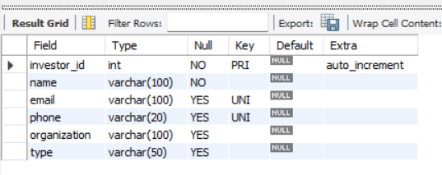
STRUCTURE OF A TABLE
INVESTORS Table:
Holds details of investors like name, type (Angel, VC, PE, Govt), and country.
Investors can participate in multiple funding rounds for different startups.
Syntax : desc Investors;

Slide 7
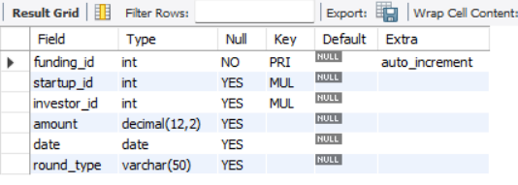
STRUCTURE OF A TABLE
FUNDINGROUNDS TABLE:
Records funding transactions between startups and investors. Includes amount, date, and round type (Seed, Series A, Series B, etc.).
Syntax : desc Fundingrounds;

Slide 8
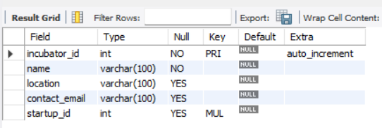
STRUCTURE OF A TABLE
Incubators Table:
Maintains details of incubators such as name, location, and contact email.
Incubators provide support, mentorship, and resources to startups.
Syntax : desc Incubators;

Slide 9
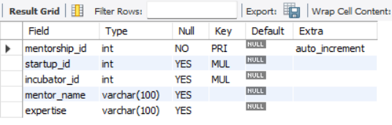
STRUCTURE OF A TABLE
Mentorship Table:
Keeps track of mentors associated with startups through incubators.
Stores mentor name and area of expertise along with linked startup and incubator.
Syntax : desc Mentorship;

Slide 10
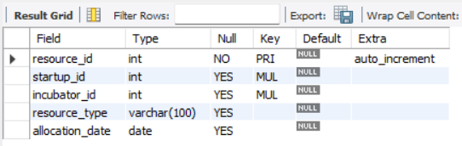
STRUCTURE OF A TABLE
Resources Table:
Manages resources allocated by incubators to startups. Includes type of resource (office space, funding aid, legal support, etc.) and allocation date.
Syntax : desc Resources;

Slide 11
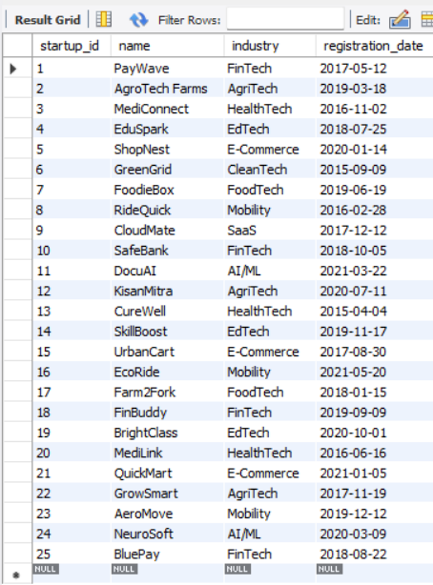
STARTUPS TABLE:
Startups Table:
Manages resources allocated by incubators to startups. Includes type of resource (office space, funding aid, legal support, etc.) and allocation date.
Syntax : Select * from Startups;

Slide 12
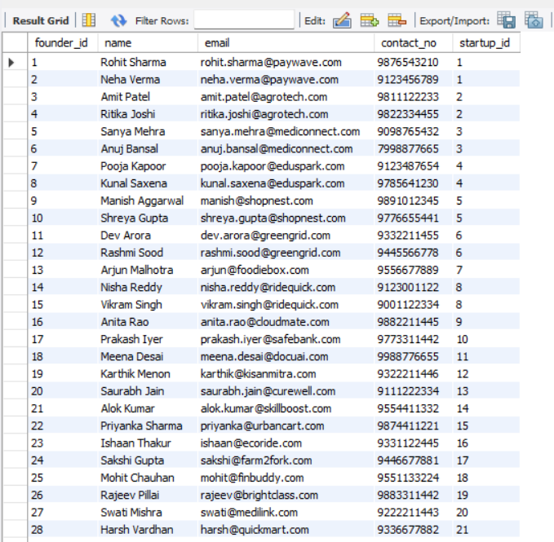
FOUNDERS TABLE:
Founders Table:
Displays all founders along with their emails, contact numbers, and linked startup.
Helps identify the people behind each startup.
Syntax : Select * from Founders;

Slide 13
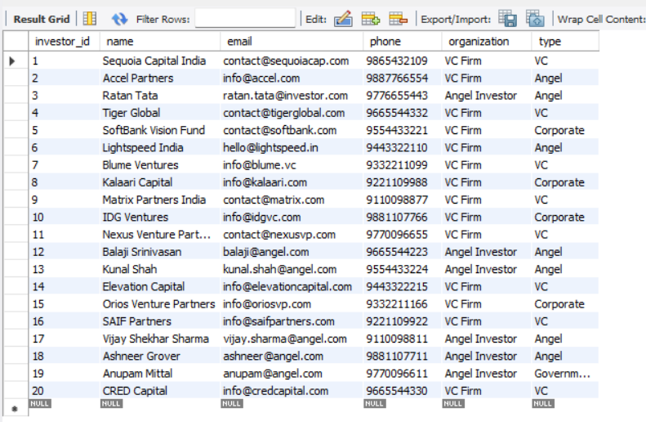
INVESTORS TABLE:
Investors Table:
Lists all investors with their type (Angel, VC, PE, Govt) and country.
Used to analyze which kind of investors are funding different startups.
Syntax : Select * from Investors;

Slide 14
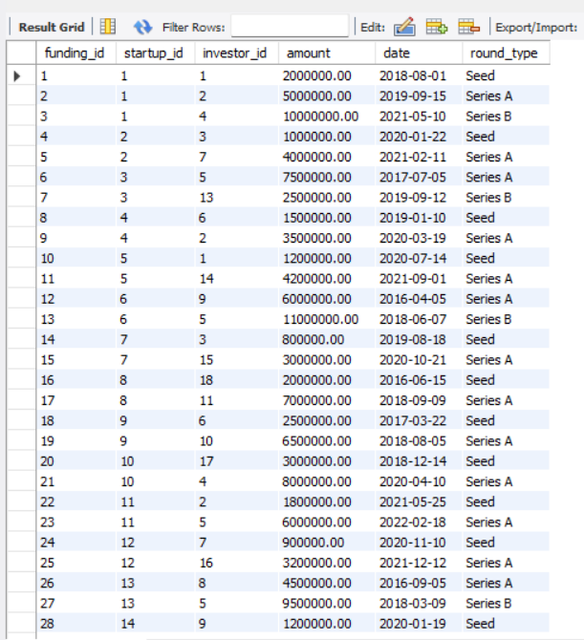
FUNDINGROUNDS TABLE:
FundingRounds Table:
Shows funding details like startup, investor, amount, date, and round type.
Used to track investments and growth stages of startups.
Syntax : Select * from FundingRounds;

Slide 15
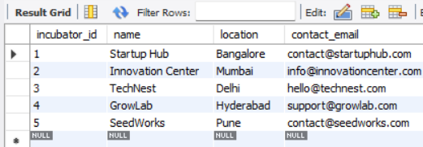
INCUBATORS TABLE:
Incubators Table:
Displays incubators with their name, location, and contact email.
Helps identify the support centers associated with startups..
Syntax : Select * from Incubator;

Slide 16
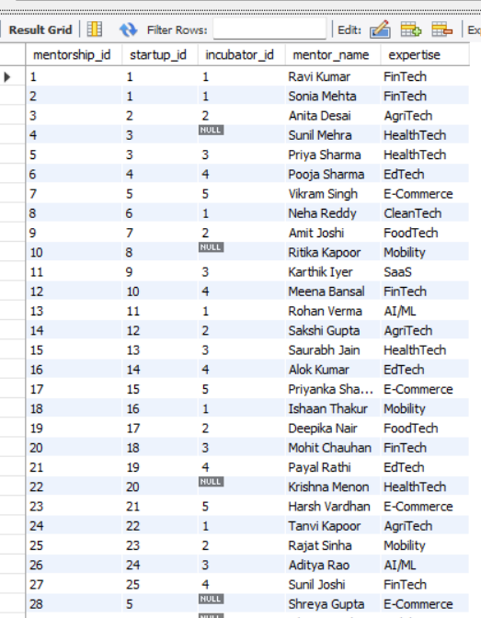
MENTORSHIP TABLE:
Mentorship Table:
Shows mentors linked with startups via incubators, along with their expertise.
Helps track guidance and domain knowledge given to startups.
Syntax : Select * from Mentorship;

Slide 17
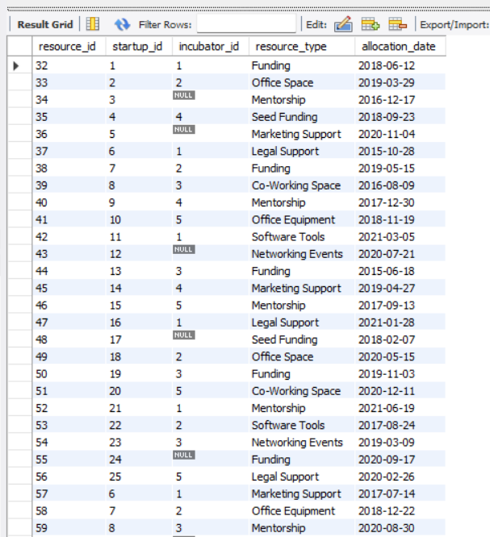
RESOURCES TABLE:
Resources Table:
Lists resources allocated to startups by incubators, like office space or legal support.
Used to manage support services given to startups.
Syntax : Select * from Resources;

Slide 18



STARTUP FUNDING
SUBQUERY

Slide 19
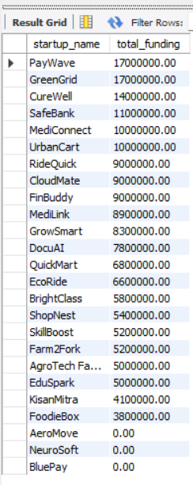
SUBQUERY
Total Funding Received by Each Startup
Syntax :
SELECT s.name AS startup_name,
(SELECT COALESCE(SUM(fr.amount), 0)
FROM FundingRounds fr
WHERE fr.startup_id = s.startup_id) AS total_funding
FROM Startups s
ORDER BY total_funding DESC;

Slide 20
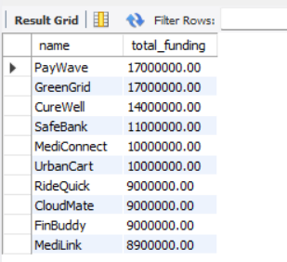
SUBQUERY
Top-funded Startups
Syntax :
SELECT name, (SELECT SUM(amount)
FROM FundingRounds
WHERE startup_id = s.startup_id) AS
total_funding
FROM Startups s
ORDER BY total_funding DESC
LIMIT 10;

Slide 21
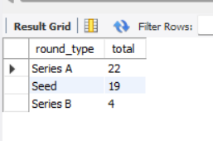
SUBQUERY
Most common type of funding
Syntax :
SELECT round_type, COUNT(*) AS total
FROM FundingRounds
GROUP BY round_type
ORDER BY total DESC;

Slide 22
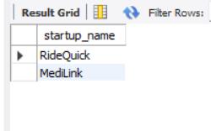
SUBQUERY
Startups without any incubator-assigned mentor
Syntax :
SELECT s.name AS startup_name
FROM Startups s
WHERE NOT EXISTS (
SELECT *
FROM Mentorship m
WHERE m.startup_id = s.startup_id
AND m.incubator_id IS NOT NULL);

Slide 23
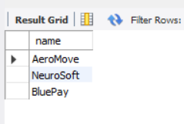
SUBQUERY
Syntax :
SELECT name
FROM Startups
WHERE startup_id NOT IN (
SELECT DISTINCT startup_id
FROM FundingRounds
);
Startups With No Funding

Slide 24
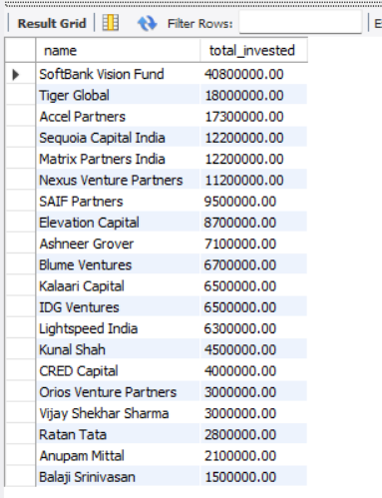
SUBQUERY
Total Invested by Each Investor
Syntax :
SELECT name,
(SELECT SUM(amount)
FROM FundingRounds
WHERE investor_id= i.investor_id)
AS total_invested
FROM Investors i
ORDER BY total_invested DESC;

Slide 25
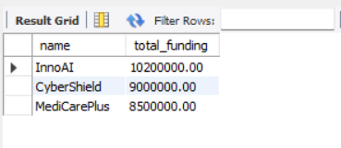
SUBQUERY
Show the top 3 startups with the highest total funding.
Syntax :
SELECT s.name,
(SELECT SUM(amount)
FROM FundingRounds fr
WHERE fr.startup_id = s.startup_id) AS total_funding
FROM Startups s
ORDER BY total_funding DESC
LIMIT 3;

Slide 26
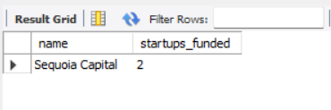
SUBQUERY
Find the investor who invested in
Multiple startups.
Syntax :
SELECT i.name AS investor_name,
(SELECT COUNT(DISTINCT fr.startup_id)
FROM FundingRounds fr
WHERE fr.investor_id =
i.investor_id) AS startups_invested
FROM Investors i
HAVING startups_invested > 1
ORDER BY startups_invested DESC;

Slide 27
STARTUP FUNDING
JOINS

Slide 28
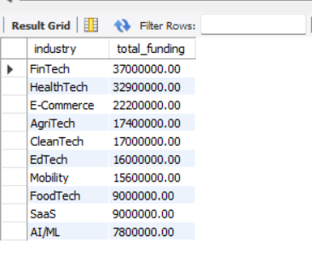
JOINS
Total Funding per Industry
Syntax :
SELECT s.industry, SUM(fr.amount) AS total_funding
FROM Startups s
JOIN FundingRounds fr ON s.startup_id = fr.startup_id
GROUP BY s.industry
ORDER BY total_funding DESC;

Slide 29
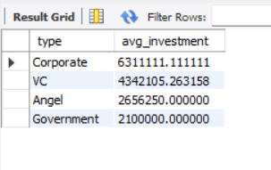
JOINS
Average Funding per Investor Type
Syntax :
SELECT i.type, AVG(fr.amount) AS avg_investment
FROM Investors i
JOIN FundingRounds fr ON
i.investor_id = fr.investor_id
GROUP BY i.type
ORDER BY avg_investment DESC;

Slide 30
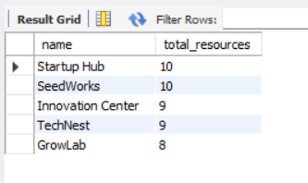
JOINS
Incubator With Highest Resource Allocation
Syntax :
SELECT i.name, COUNT(r.resource_id)
AS total_resources
FROM Incubators i
JOIN Resources r ON i.incubator_id = r.incubator_id
GROUP BY i.incubator_id
ORDER BY total_resources DESC;

Slide 31
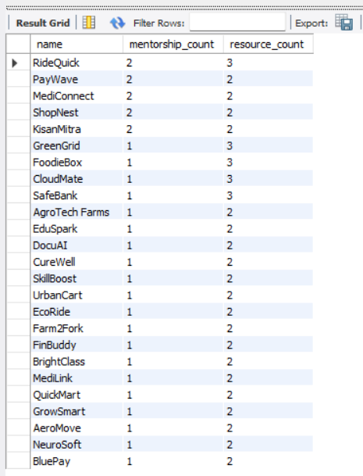
JOINS
Startups With Both Mentorship and Resources
Syntax :
SELECT s.name, COUNT(DISTINCT m.mentorship_id) AS mentorship_count, COUNT(DISTINCT r.resource_id) AS resource_count FROM Startups s LEFT JOIN Mentorship m ON s.startup_id = m.startup_id
LEFT JOIN Resources r ON s.startup_id = r.startup_id
GROUP BY s.startup_id
ORDER BY mentorship_count DESC, resource_count DESC;

Slide 32
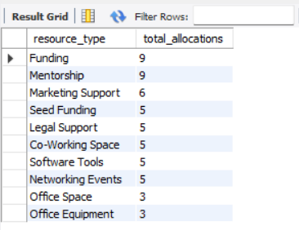
JOINS
Most Popular Resource Types
Syntax :
SELECT r.resource_type, COUNT(*) AS total_allocations
FROM Resources r
GROUP BY r.resource_type
ORDER BY total_allocations DESC;

Slide 33
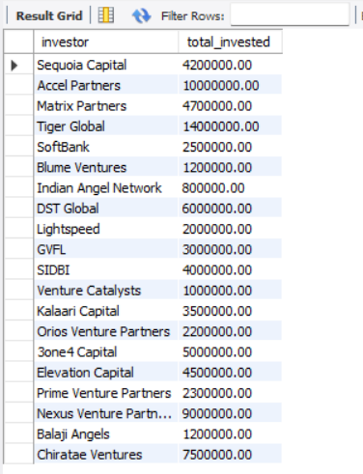
JOINS
Incubators Supporting Most Funded Startups
Syntax :
SELECT inc.name, COUNT(DISTINCT s.startup_id) AS funded_startups FROM Incubators inc JOIN Mentorship m ON inc.incubator_id = m.incubator_id
JOIN FundingRounds fr ON m.startup_id = fr.startup_id
JOIN Startups s ON fr.startup_id = s.startup_id
GROUP BY inc.incubator_id
ORDER BY funded_startups DESC;

Slide 34
JOINS
How much total funding did each investor give?
Syntax :
SELECT i.name AS investor,
SUM(fr.amount) AS total_invested
FROM Investors i
JOIN FundingRounds fr
ON i.investor_id = fr.investor_id
GROUP BY i.name;

Slide 35
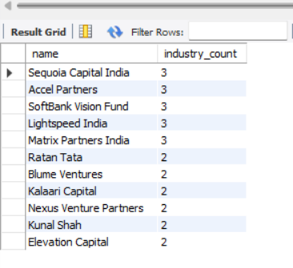
JOINS
Investors Funding Multiple Industries
Syntax :
SELECT i.name, COUNT(DISTINCT s.industry) AS industry_count
FROM Investors i
JOIN FundingRounds fr ON i.investor_id = fr.investor_id
JOIN Startups s ON fr.startup_id = s.startup_id
GROUP BY i.investor_id
HAVING industry_count > 1
ORDER BY industry_count DESC;

Slide 36
STARTUP FUNDING
VIEWS

Slide 37
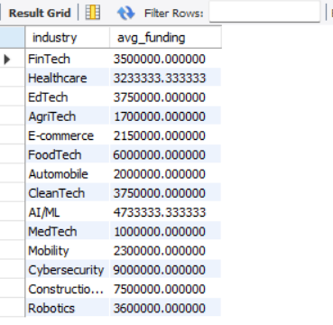
VIEWS
Average Funding Amount per
Industry
Syntax :
CREATE VIEW v_avg_industry_funding AS
SELECT s.industry,
AVG(f.amount) AS avg_funding
FROM Startups s
JOIN FundingRounds f
ON s.startup_id = f.startup_id
GROUP BY s.industry;

Slide 38
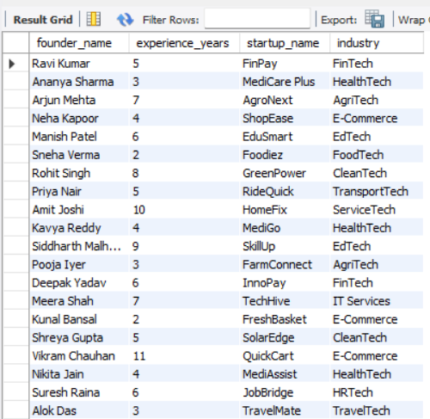
VIEWS
List all founders with their startup
Syntax :
CREATE VIEW v_founder_startup AS
SELECT f.name AS founder_name,
f.experience_years,
s.name AS startup_name,
s.industry
FROM Startups s
JOIN Founders f ON s.founder_id = f.founder_id;

Slide 39
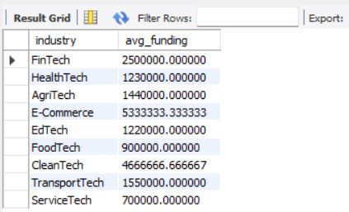
VIEWS
Average funding per industry
Syntax :
CREATE VIEW v_avg_funding_industry AS
SELECT s.industry, AVG(f.amount) AS avg_funding
FROM Startups s
JOIN FundingRounds f ON s.startup_id = f.startup_id
GROUP BY s.industry;

Slide 40
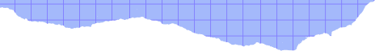



THANK
YOU!
T348-AAYUSH SINGH

